Slide 1
Northern Cross Energy Limited RNG for South Bruce

Slide 2
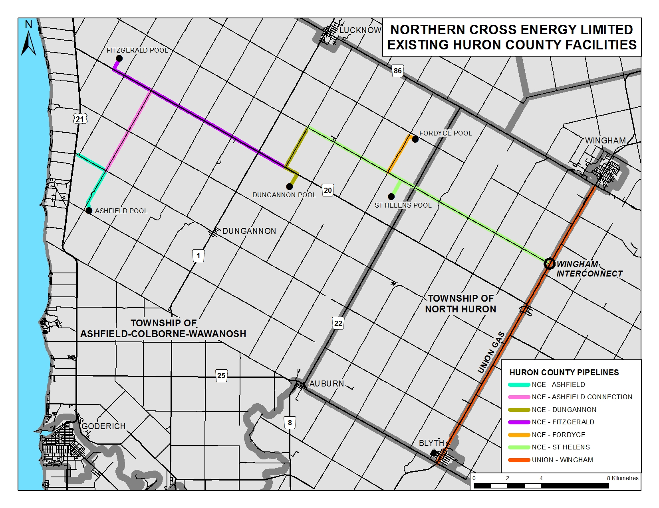

Slide 3
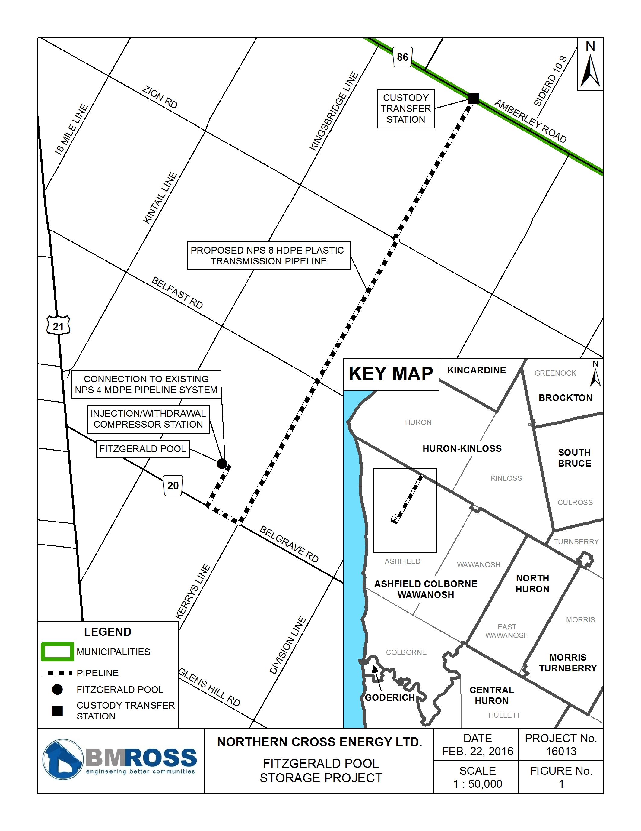
Fitzgerald Pool Storage Serving New
South Bruce System

Slide 4
RNG: System Concepts
Fitzgerald Pool
and
Pipeline
Interface with EPCOR at Amberley Road & Kerry’s Line
Accept storage volumes in summer from EPCOR and blend 5% hydrogen into storage volumes at wellhead (make RNG)
Redeliver RNG volumes to EPCOR in winter
Access new Ontario government funding to help finance RNG component

Slide 5
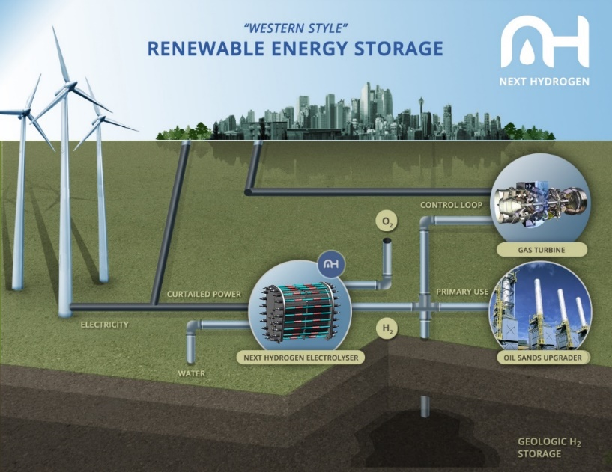
“Alberta Climate Change Action”
SMR is lowest cost pathway to emission benefits from “over-generation” of renewable electricity – “best energy storage strategy”.
Grid management tools of electrolysis network enables greater penetration of renewables resulting in further decarbonization of grid
Demand for industrial hydrogen infrastructure will lead to further reduction in manufacturing costs of electrolysis modules
Notes:
Renewable Energy Solution
Cost-effective utility-scale enabler
Utility scale energy storage

Slide 6
Storage System: Key Metrics
Fitzgerald Pool
and
Pipeline
HDPE Plastic Main – 6 miles of 8” with MOP of 180 psig
Utilizes 19% of total capacity (8,600,000 m3 at 2,100 kPaa of 45,308,000 m3 at 6,895 Kpaa - based on EPCOR RFP)
New horizontal leg on existing vertical well completed to MNR storage standards
Locate hydrogen electrolyser at Fitzgerald Pool

Slide 7
Hydrogen System: Scenario 1
Fitzgerald Pool
(EPCOR Forecasted Volume)
Natural Gas Storage Volume: 8,600,000 m3/y
Hydrogen Volume at 5% blend by volume: 430,000 m3/y
Hydrogen Production Rate: 71.88 m3/h

Slide 8
Hydrogen System: Scenario 2
Fitzgerald Pool
(Zero Upstream Reinforcement at Dornoch)
Natural Gas Storage Volume: 9,600,000 m3/y
Hydrogen Volume at 5% blend by volume: 480,000 m3/y
Hydrogen Production Rate: 79.80 m3/h

Slide 9
Hydrogen System: Scenario 3
Fitzgerald Pool
(Maximize RNG Production)
This could take many forms
Goal would be to maximize RNG production
Rework of EPCOR pipeline design would be required

Slide 10
Northern Cross Energy Key Features
Advantages of Working with NCE
Local storage: natural gas and power –to-gas (hydrogen)
Improved security of supply: 3 sources on winter days
No Union upstream reinforcement required
RNG

